Slide 1
Snowflake & DBT
Project
Company Name
Month Year

Slide 2
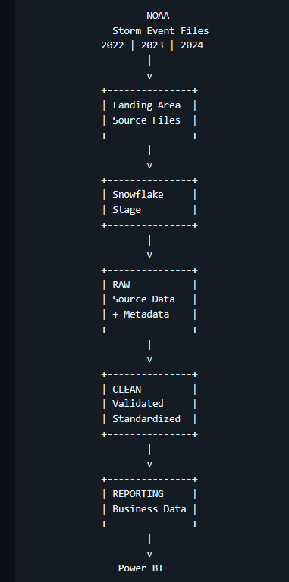
Architecture

Slide 3
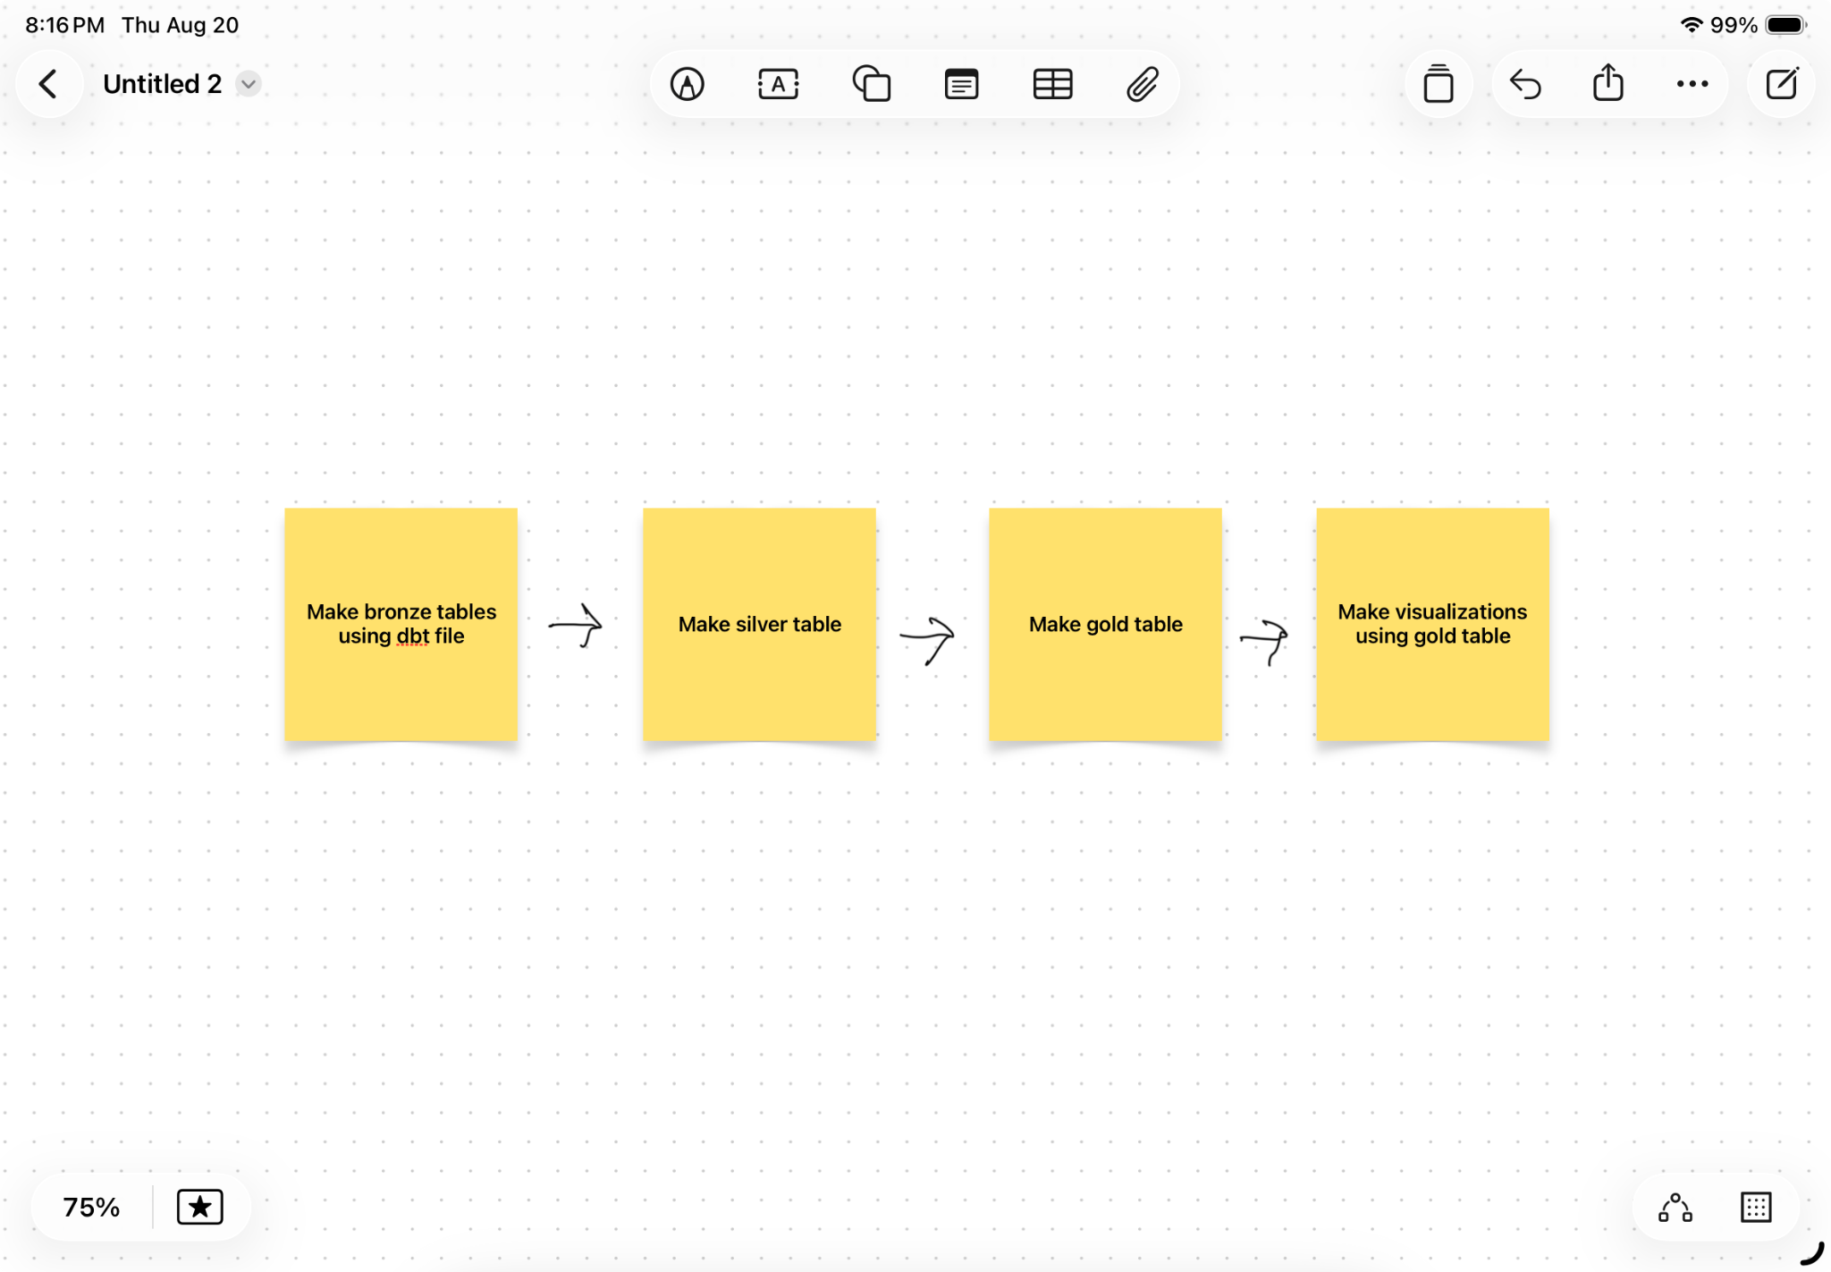

Slide 4


